Slide 1
Dear Pergamum,
The Compromising Yet Continuing Church
Preached Originally by Dr. Ron Sheveland then edited and expanded by Dr. Rick Griffith, Crossroads International Church
cicfamily.com & BibleStudyDownloads.org

Slide 2

Pergamum (Rev. 2:12-17)
353
Pergamum
Thyatira
Christ:
Has the sharp, double-edged sword
Smyrna
Sardis
Ephesus
Philadelphia
Laodicea

Slide 3
Pergamum (Rev. 2:12-17)
353
Pergamum
Thyatira
Commendation:
Remains true to Christ; does not renounce her faith
Christ:
Has the sharp, double-edged sword
Smyrna
Sardis
Ephesus
Philadelphia
Laodicea

Slide 4
Pergamum (Rev. 2:12-17)
353
Pergamum
Thyatira
Rebuke
People there hold the teachings of Balaam and of the Nicolaitans
Commendation:
Remains true to Christ; does not renounce her faith
Christ:
Has the sharp, double-edged sword
Smyrna
Sardis
Ephesus
Philadelphia
Laodicea

Slide 5
Pergamum (Rev. 2:12-17)
353
Pergamum
Thyatira
Exhortation
Repent!
Rebuke
People there hold the teachings of Balaam and of the Nicolaitans
Commendation:
Remains true to Christ; does not renounce her faith
Christ:
Has the sharp, double-edged sword
Smyrna
Sardis
Ephesus
Philadelphia
Laodicea

Slide 6
Pergamum (Rev. 2:12-17)
353
Pergamum
Warning
If you do not repent,
I will make war against those people with the sword of my mouth
Thyatira
Exhortation
Repent!
Rebuke
People there hold the teachings of Balaam and of the Nicolaitans
Commendation:
Remains true to Christ; does not renounce her faith
Christ:
Has the sharp, double-edged sword
Smyrna
Sardis
Ephesus
Philadelphia
Laodicea

Slide 7
Pergamum (Rev. 2:12-17)
353
Promise
Will receive hidden manna and white stone with a new name on it
Pergamum
Warning
If you do not repent,
I will make war against those people with the sword of my mouth
Thyatira
Exhortation
Repent!
Rebuke
People there hold the teachings of Balaam and of the Nicolaitans
Commendation:
Remains true to Christ; does not renounce her faith
Christ:
Has the sharp, double-edged sword
Smyrna
Sardis
Ephesus
Philadelphia
Laodicea

Slide 8
Revelation 2:12-17
¹²To the angel of the church in Pergamum write: These are the words of him who has the sharp, double-edged sword. ¹³I know where you live—where Satan has his throne. Yet you remain true to my name. You did not renounce your faith in me, even in the days of Antipas, my faithful witness, who was put to death in your city—where Satan lives.
¹⁴Nevertheless, I have a few things against you: You have people there who hold to the teaching of Balaam, who taught Balak to entice the Israelites to sin by eating food sacrificed to idols and by committing sexual immorality. ¹⁵Likewise you also have those who hold to the teaching of the Nicolaitans. ¹⁶Repent therefore! Otherwise, I will soon come to you and will fight against them with the sword of my mouth.
¹⁷He who has an ear, let him hear what the Spirit says to the churches. To him who overcomes, I will give some of the hidden manna. I will also give him a white stone with a new name written on it, known only to him who receives it.

Slide 9
Christ's Commission
Jesus tells John to send this letter
"To the angel (or messenger) of the church of Pergamum" (2:12)

Slide 10
Christ's Commendation
2:13 "I know where you live—where Satan has his throne. Yet you remain true to my name. You did not renounce your faith in me, even in the days of Antipas, my faithful witness, who was put to death in your city— where Satan lives."

Slide 11
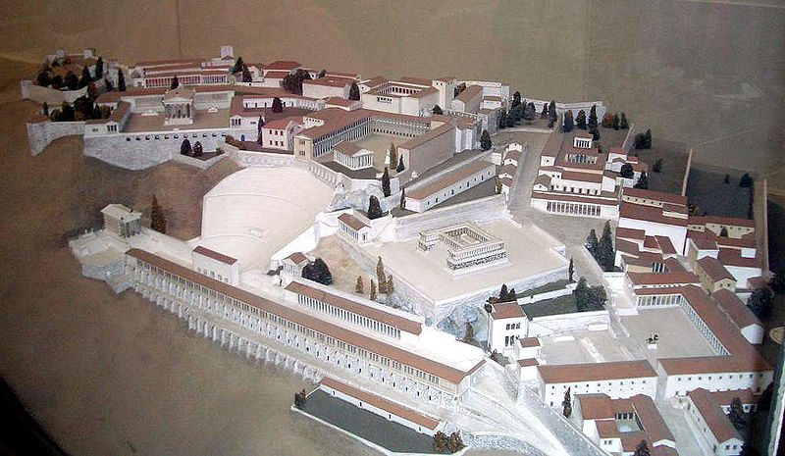
Model of Pergamum:
Continuing Yet Compromising
353
Notes:
It has long been assumed that the temple was dedicated to Zeus. The altar is mentioned in the Book of Revelation, 2:11-12: "To the angel of the church in Pergamum, write this: . . . 'I know that you live where Satan's throne is . . . . '" This is a scale model of the altar.

Slide 12
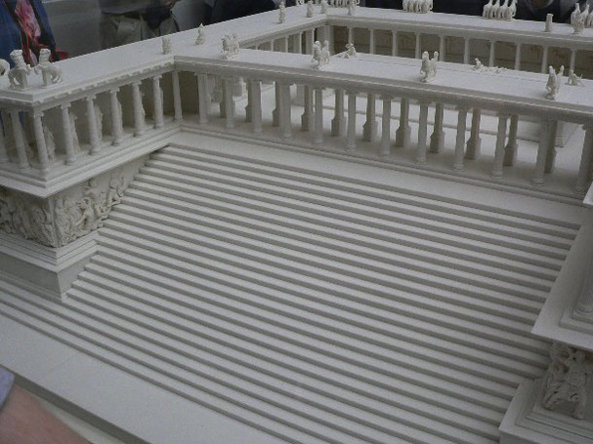
Altar of Zeus
353
"I know where you live—where Satan has his throne" (2:13)
Notes:
It has long been assumed that the temple was dedicated to Zeus. The altar is mentioned in the Book of Revelation, 2:11-12: "To the angel of the church in Pergamum, write this: . . . 'I know that you live where Satan's throne is . . . . '" This is a scale model of the altar.

Slide 13
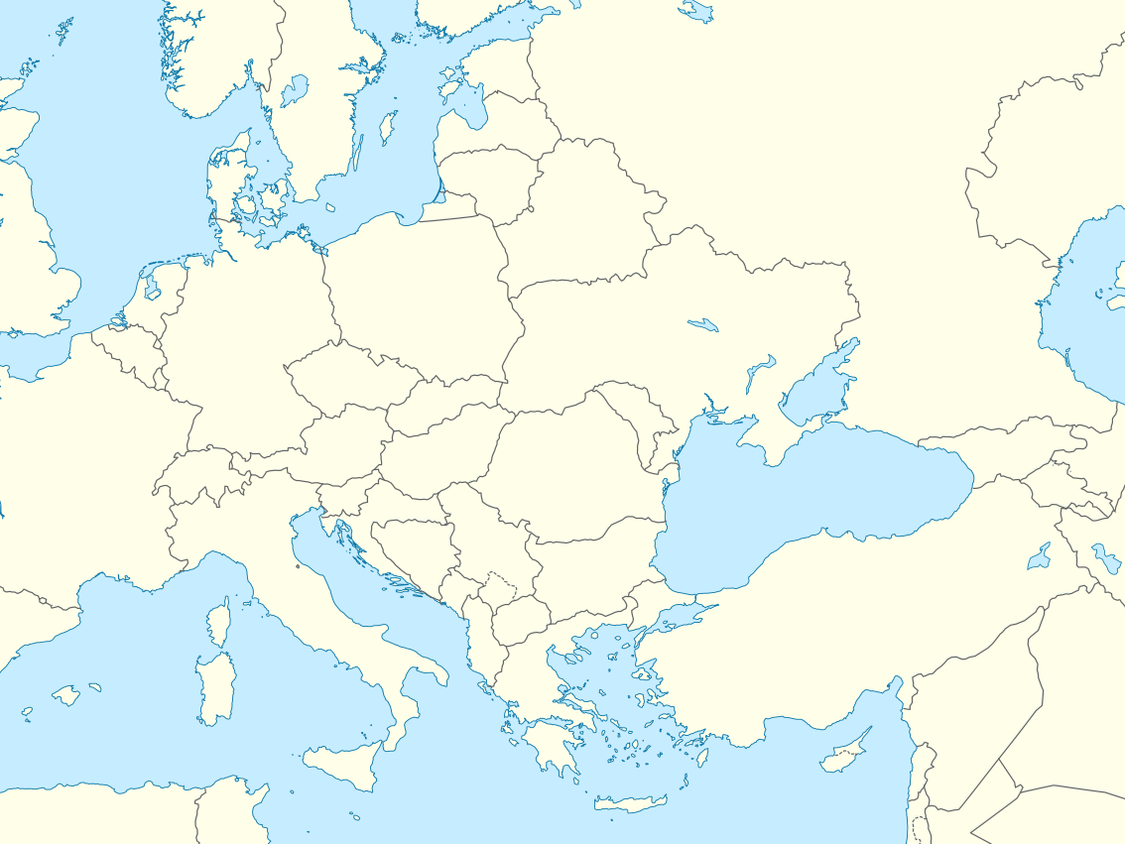
Babylon Religion Moved West
Rome
Pergamum
Babylon
Notes:
"After the Persians took over Babylon in 539 B.C., they discouraged the continuation of the mystery religions of Babylon. Subsequently the Babylonian cultists moved to Pergamum (or Pergamos) where one of the seven churches of Asia Minor was located (cf. Rev. 2:12-17)… When the teachers of the Babylonian mystery religions later moved from Pergamum to Rome, they were influential in paganizing Christianity and were the source of many so-called religious rites which have crept into ritualistic churches" (Walvoord, BKC).

Slide 14
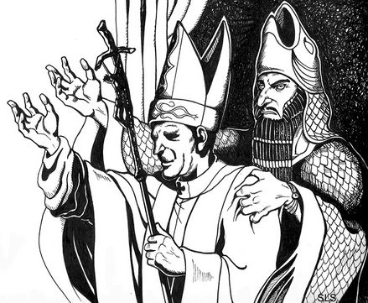
Babylon Religion Moved West
Pontifex Maximus
"Major Keeper of the Bridge"
"Keeper of the Bridge" between man and Satan
Rome
Pergamum
Babylon
Notes:
"Crowns in the shape of a fish head were worn by the chief priests of the Babylonian cult to honor the fish god. The crowns bore the words "Keeper of the Bridge," symbolic of the "bridge" between man and Satan. This handle was adopted by the Roman emperors, who used the Latin title Pontifex Maximus, which means "Major Keeper of the Bridge." And the same title was later used by the bishop of Rome. The pope today is often called the pontiff, which comes from pontifex. " (Walvoord, BKC).

Slide 15
Christ's Condemnation
    2:14 "Nevertheless, I have a few things against you: You have people there who hold to the teaching of Balaam, who taught Balak to entice the Israelites to sin by eating food sacrificed to idols and by committing sexual immorality. ¹⁵Likewise you also have those who hold to the teaching of the Nicolaitans."

Slide 16
Some of their members held to the doctrine of Balaam
2:14 "Nevertheless, I have a few things against you: You have people there who hold to the teaching of Balaam, who taught Balak to entice the Israelites to sin by eating food sacrificed to idols and by committing sexual immorality."

Slide 17

Numbers
354
Preparation to Occupy the Land
Preparing the
Old Generation
Postponement
for Unbelief
Preparing the
New Generation
1:1–10:10
10:11–25:18
26–36
God's Faithfulness
Israel's Faithlessness
God's Faithfulness
God's Blessings
God's Discipline
God's Blessings
Israel's Commitment
Israel's Complaining
Israel's Commitment
Order
Disorder
Reorder
Mount Sinai
Wilderness
Moab
20 Days
38 Years, 3 Months, 10 Days
ca. 5 Months
Organization
(1-4)
Sanctification (5:1-10:10)
To Kadesh (10:11-
12:16)
Kadesh Sin
(13-14)
Wilder-ness (15-19)
To Moab (20-21)
Moab
Sin
(22-25)
Provision for Land (26-27)
Offerings & Vows (28-30)
Final Preparations (31-36)

Slide 18
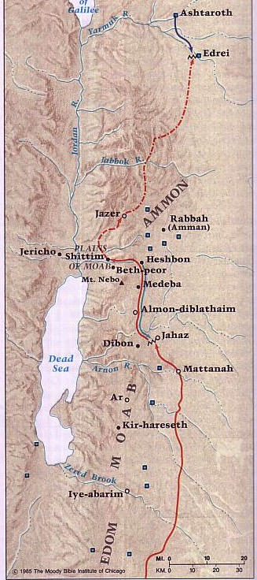
Transjordan Events
OTS 140
Victory over Sihon and Og (Num. 21)
Balak fails to turn God against Israel–blessing by Balaam (Num. 22-24)

Slide 19

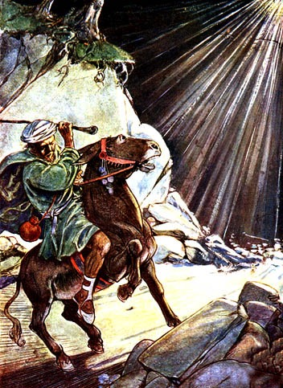
Balaam
354
Balaam Numbers 22–24

Slide 20
Revelation 2:14-15
Nevertheless, I have a few things against you: You have people there who hold to the teaching of Balaam, who taught Balak to entice the Israelites to sin by eating food sacrificed to idols and by committing sexual immorality. Likewise you also have those who hold to the teaching of the Nicolaitans.
354

Slide 21
2 Peter 2:15-16 (NIV)
354
They have left the straight way and wandered off to follow the way of Balaam son of Beor, who loved the wages of wickedness. But he was rebuked for his wrongdoing by a donkey–a beast without speech–who spoke with a man's voice and restrained the prophet's madness.

Slide 22
Jude 11 (NIV)
354
Woe to them! They have taken the way of Cain; they have rushed for profit into Balaam's error; they have been destroyed in Korah's rebellion.

Slide 23
Transjordan Events
OTS 140
Victory over Sihon and Og (Num. 21)
Balak fails to turn God against Israel–blessing by Balaam (Num. 22-24)
Balak succeeds to turn Israel against God by immorality at Beth Peor (Num. 25)

Slide 24
Some of their members held to the doctrine of the Nicolaitans
2:15 "Likewise you also have those who hold to the teaching of the Nicolaitans."

Slide 25
Christ's Correction
2:16 "Repent therefore! Otherwise, I will soon come to you and will fight against them with the sword of my mouth. ¹⁷He who has an ear, let him hear what the Spirit says to the churches. To him who overcomes, I will give some of the hidden manna. I will also give him a white stone with a new name written on it, known only to him who receives it."

Slide 26
Repent...
2:16 "Repent therefore! Otherwise, I will soon come to you and will fight against them with the sword of my mouth."

Slide 27
Receive…
2:17 "He who has an ear, let him hear what the Spirit says to the churches. To him who overcomes, I will give some of the hidden manna. I will also give him a white stone with a new name written on it, known only to him who receives it."

Slide 28
Receive… The Bread of Life
"To him who overcomes, I will give some of the hidden manna"
(2:17a)

Slide 29
    John 6:30-35
So they asked him, "What miraculous sign then will you give that we may see it and believe you? What will you do? Our forefathers ate the manna in the desert; as it is written: 'He gave them bread from heaven to eat.'"
Jesus said to them, "I tell you the truth, it is not Moses who has given you bread from heaven, but it is my Father who gives you the true bread from heaven. For the bread of God is he who comes down from heaven and gives life to the world."
"Sir," they said, "from now on give us this bread." "Then Jesus declared, "I am the bread of life. He who comes to me will never go hungry, and he who believes in me will never be thirsty."

Slide 30
Receive… The Eternal Life
"a white stone with a new name written on it, known only to him who receives it"
(2:17b)

Slide 31
Black

Slide 32

Jesus Wins!
Series on Revelation

Slide 33


NT Survey link at BibleStudyDownloads.org
Get this presentation for free!
Notes:
NT Survey (ns)

